Slide 1
L1.2 HW/SW Platforms, V2X
Zonghua Gu 2023

Slide 2
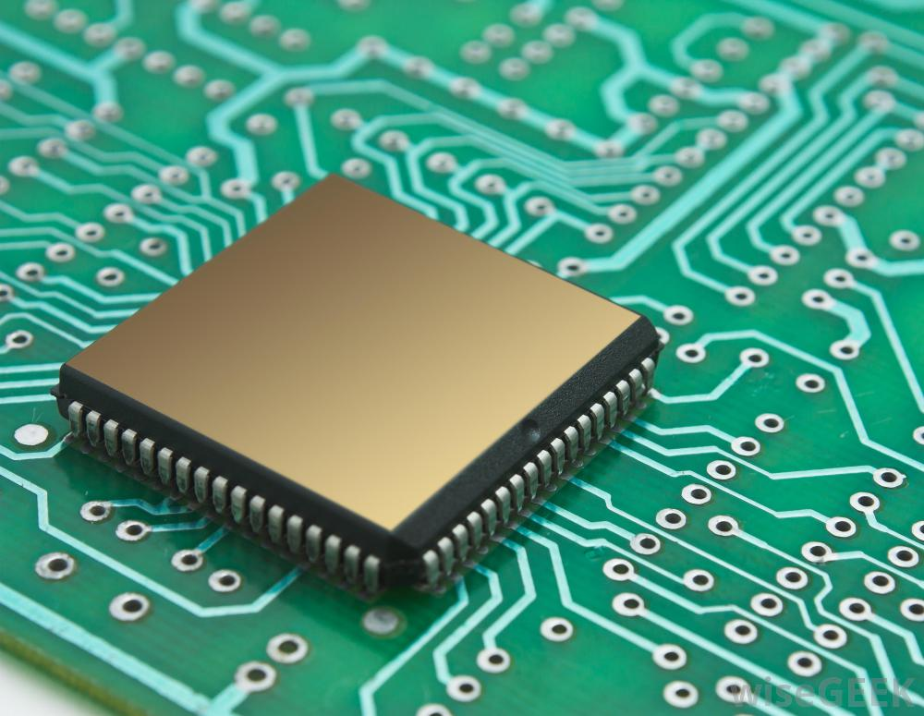
HARDWARE PLATFORMS

Slide 3
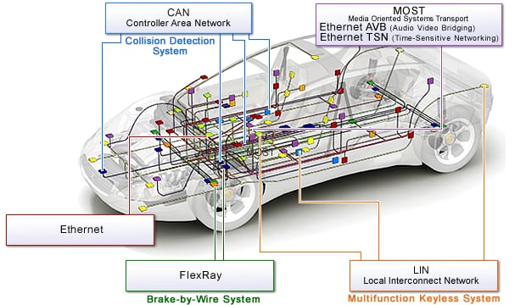
Typical Automotive E/E Architecture
Ethernet as high-bandwidth backbone network
Ethernet TSN posed to be the dominating standard protocol.
Regular Ethernet is also used for diagnostics
FlexRay for safety-critical X-by-Wire, where X stands for brake, steer, drive…
Gradually being replaced by Ethernet
Media Oriented Systems Transport (MOST) for multimedia transmission
Gradually being replaced by Ethernet
CAN (Controller Area Network) for low-bandwidth network and interfacing with sensors/actuators
LIN (Local Interconnect Network) for body electronics, e.g., door, light, rearview mirrors…
https://www.renesas.com/eu/en/solutions/automotive/technology/networking-solutions.html
Notes:
In-Vehicle Networking

Slide 4
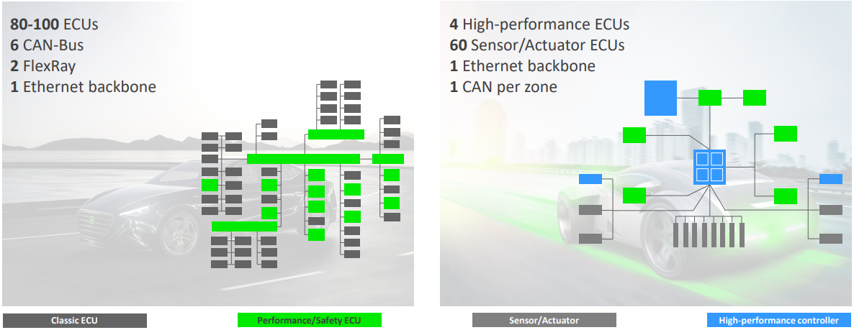
Evolution of Automotive E/E Architecture
From many (~80-100) distributed and networked ECUs to a few (~4) high-performance ECUs with massive computing power, and large number of (~60) small ECUs for interfacing with sensors and actuators.
This helps simplify system architecture, reduce network load, and improve system reliability.
Notes:
https://www.st.com/content/ccc/resource/sales_and_marketing/presentation/product_presentation/group0/02/cb/7a/e7/8d/aa/40/1e/China_STM_MCU_Techincal_Day_5_Elektrobit_AUTOSAR_Introduction/files/China_STM_MCU_Techincal_Day_5_Elektrobit_AUTOSAR_Introduction.pdf/jcr:content/translations/en.China_STM_MCU_Techincal_Day_5_Elektrobit_AUTOSAR_Introduction.pdf

Slide 5
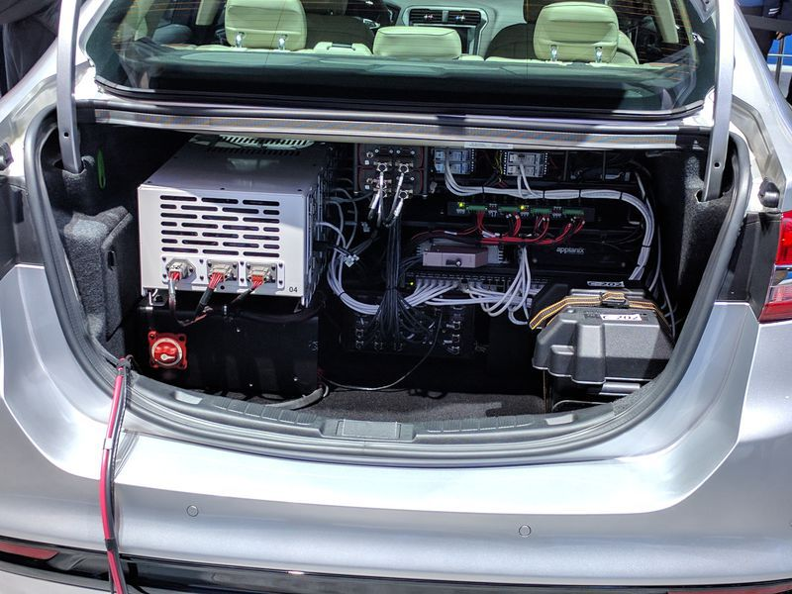

Trunk of an Experimental AV from Ford (2017)
Where do I put my groceries?
https://www.theverge.com/2017/10/10/16449416/nvidia-pegasus-self-driving-car-ai-robotaxi

Slide 6
AD Hardware Considerations
Power consumption
Power consumption of electronics (sensors and computing hardware) for AD may be 100x that of a vehicle with regular ADAS. This drains battery and implies increased fuel consumption or reduced range for EVs
EV drivers often turn off air conditioning due to range anxiety; will they turn off AD and drive manually for this reason?
Waymo and Ford now focus on Hybrid Vehicles, while Uber uses a fleet of full gasoline SUVs.
Cooling capacity
Fan or liquid cooling.
Form factor
Must be compact and unobtrusive.
Cost
Important for mass deployment.
Cost of electronics in an experimental AV often exceeds cost of the original vehicle.
Notes:
Performance of limited form factor, power consumption and cooling capacity.
Must achieve high performance under constraints
Real-time processing of sensor data
HW resource
Due to cost/power/thermal constraints
(some estimate it to be 2.5KW)

Slide 7
SoC Hardware for AVs
The most compute-intensive workload is Deep Learning
Mostly inference tasks, but may also perform training tasks in case of online-learning.
Many vendors provide SoC (System-on-Chip) products that integrate CPU cores with specialized computational engines for Deep Learning:
GPU (Graphics Processing Unit)
NVIDIA is the only serious player.
Other GPU venders, e.g., AMD, ARM, Intel, focus on computer graphics instead of general-purpose computing (GPGPU).
FPGA (Field-Programmable Gate Arrays)
Xilinx, Intel Altera
ASIC (Application-Specific Integrated Circuit)
An explosion of specialized ASICs for Deep Learning in recent years, with hundreds of companies and products ranging from high-performance to embedded.
DSP (Digital Signal Processor)
Mainly for image preprocessing, e.g., products from Texas Instruments.

Slide 8
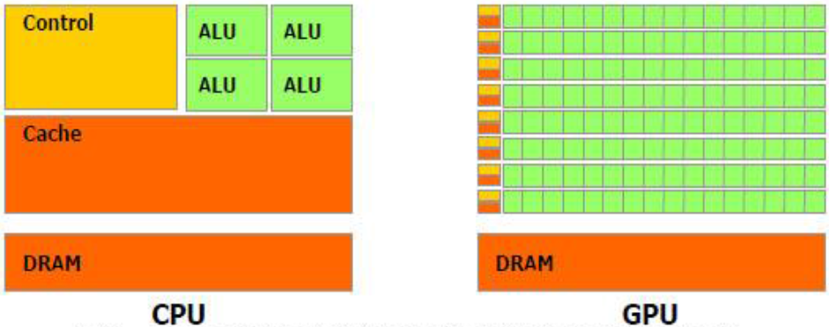
CPU vs. GPU
GPU has much simpler control logic than CPU, hence has more computational elements (Arithmetic Logic Units)
GPU is ideally suited for processing highly-parallel workloads
e.g. matrix-multiply, which is a core operation in Deep Learning algorithms

Slide 9
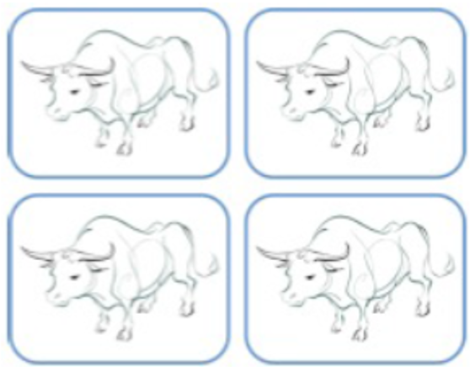
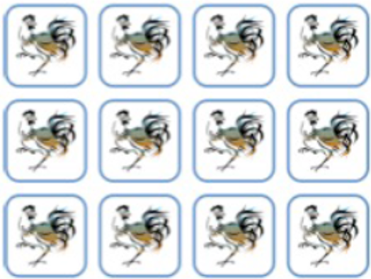
CPU vs. GPU
When you are plowing a field, would you prefer 4 strong oxen (a multicore CPU), or 1024 chickens (a GPU)?
Similar arguments for FPGAs (Field-Programmable Gate Arrays) and ASICs (Application-Specific Integrated Circuits)

Slide 10
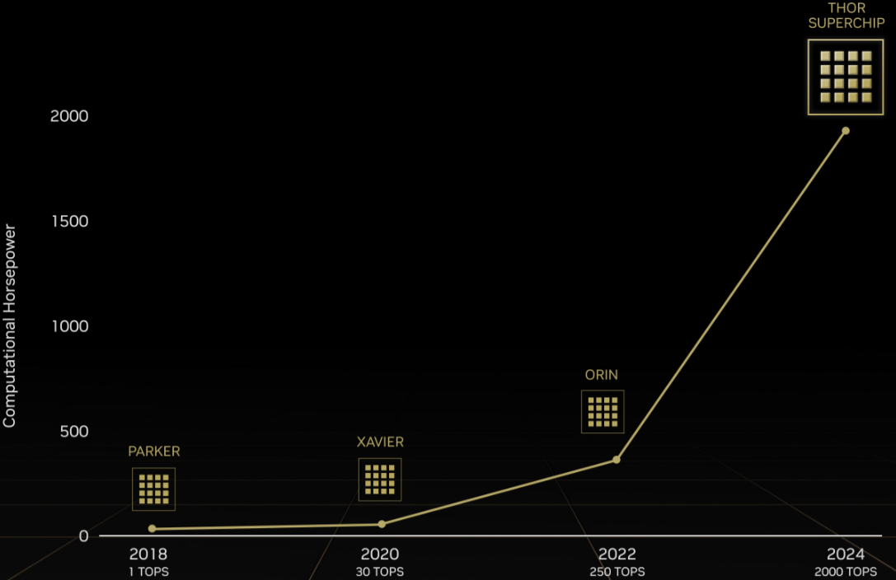
NVIDIA DRIVE Hardware
A family of products, ranging from the low-end Parker to the latest high-end THOR with 2000 TOPS (Tera Operations Per Second)
Besides CPU and GPU cores, also includes NVDLA (NVIDIA Deep Learning Accelerator), an ASIC for Deep Learning inference.
https://wccftech.com/nvidia-intros-drive-thor-balancing-ai-performance-for-full-vehicle-autonomy/
Notes:
https://devblogs.nvidia.com/jetson-xavier-nx-the-worlds-smallest-ai-supercomputer/
Xavier is claimed to be “the world’s first processor designed for autonomous driving.”
https://www.forbes.com/sites/tiriasresearch/2019/12/18/nvidia-announces-new-orin-auto-ai-processor/
, to the low-end Jetson Xavier NX (shown below) with 21 TOPS under 15W of power, or up to 14 TOPS of under 10W.

Slide 11
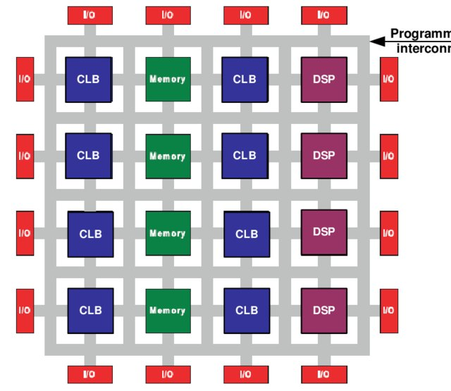
FPGAs
FPGA is reprogrammable hardware, consisting of an array of Configurable Logic Blocks (CLBs) and interconnections which can be configured at design time or runtime.
Notes:
https://www.researchgate.net/publication/290929451_Field_Programmable_Gate_Array_FPGA_From_Conventional_to_Modern_Architectures/figures?lo=1

Slide 12
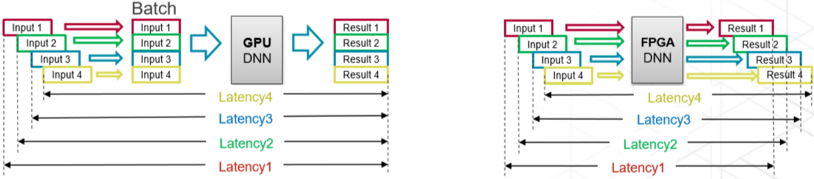
FPGA vs. GPU
FPGA has advantages over GPU for Deep Learning inference tasks.
GPU performs computation in batches for efficient exploitation of SIMD (Single Instruction, Multiple Data) computation model.
This is ideally suited for training tasks, with well-known algorithms such as Stochastic Gradient Descent with mini-batches.
But not ideal for inference tasks.
Larger batch size leads to high throughput, but also high and nondeterministic latency for each data item.
Smaller batch size leads to low computation efficiency.
FPGA can perform “batch-less” inference
Low and deterministic latency for any batch size.
https://www.eetimes.com/where-do-fpgas-stand-in-auto-ic-race/#

Slide 13
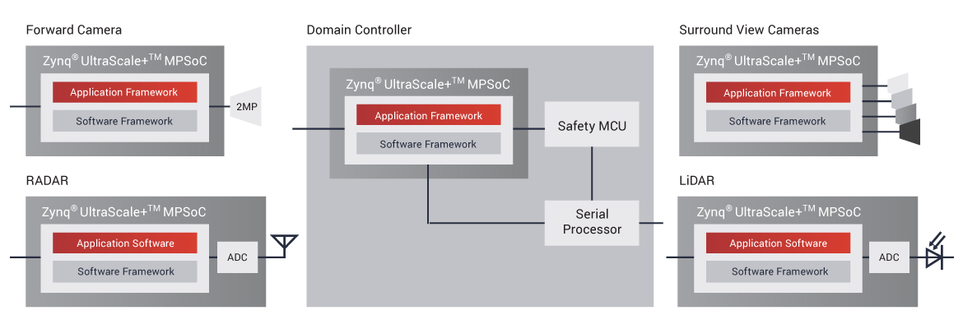
FPGA for Automotive
FPGAs can be integrated into sensors (camera, Lidar, radar), or serve as central compute engine in domain controller or AD computer
Xilinx FPGAs have 90% market share in lidars.
Intel is pushing hard into the automotive market, with acquisition of Altera in 2015.
https://www.xilinx.com/applications/automotive/automated-driving.html

Slide 14
ASICs
ASICs for Deep Learning are often called Neural Processing Units or AI accelerators.
ASICs, thanks to dedicated circuit design, may achieve up to 10x in computation efficiency and power consumption compared to CPU/GPU, and less dramatic, but still significant improvement compared to FPGA. The drawback is loss of programmability and flexibility.
Industry: almost every chip vendor provides some kind of AI accelerator, e.g. Google’s Tensor Processing Unit (TPU)
Academia: AI accelerators is a dominating topic in top conferences in computer architecture, including ISCA, MICRO and HPCA.

Slide 15
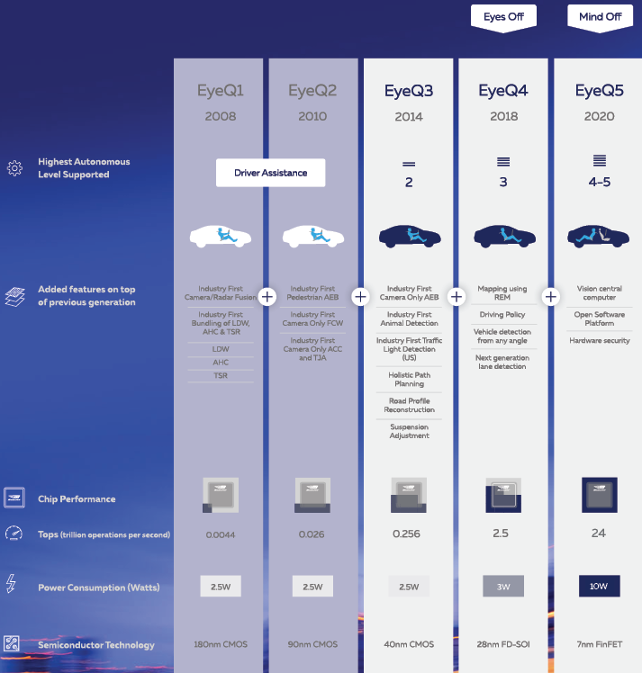
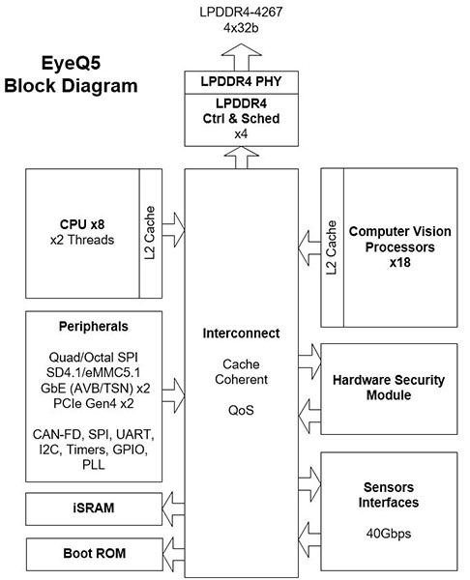
MobileEye EyeQ Series
“Computer Vision Processors” are ASICs
https://www.mobileye.com/our-technology/evolution-eyeq-chip/
Notes:
https://www.mobileye.com/our-technology/evolution-eyeq-chip/

Slide 16
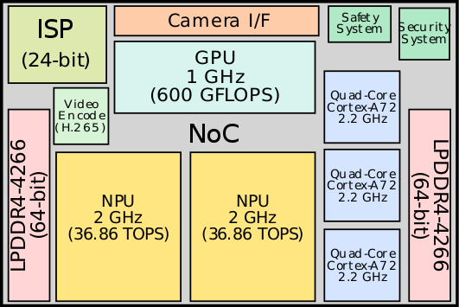
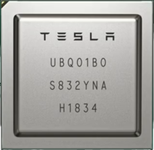
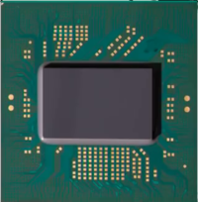
Tesla FSD
Full Self-Driving Chip (FSD) is designed by Tesla and introduced in early 2019 for their own cars.
It incorporates 3 quad-core Cortex-A72 clusters for a total of 12 CPUs operating at 2.2 GHz, a GPU operating 1 GHz, 2 Neural Processing Units (NPUs) operating at 2 GHz, and various other hardware accelerators.
NPU: ASIC for Deep Learning inference

Slide 17
Products from Automotive OEMs and Suppliers
These companies do not design chips. Rather, they offer integration solutions based on products from chip vendors like NVIDIA.
Delphi/Audi zFAS (zentrales Fahrerassistenz-Steuergeraet)
based on NVIDIA Tegra K1 and Mobileye EyeQ3
Hedging their bet on products from two mortal enemies ☺
ZF ProAI
based on NVIDIA DRIVE PX2
Bosch AI Car Computer
based on NVIDIA DRIVE AGX Xavier
Continental ADCU; Visteon DriveCore; NXP BlueBox; Renesas R-Car…

Slide 18
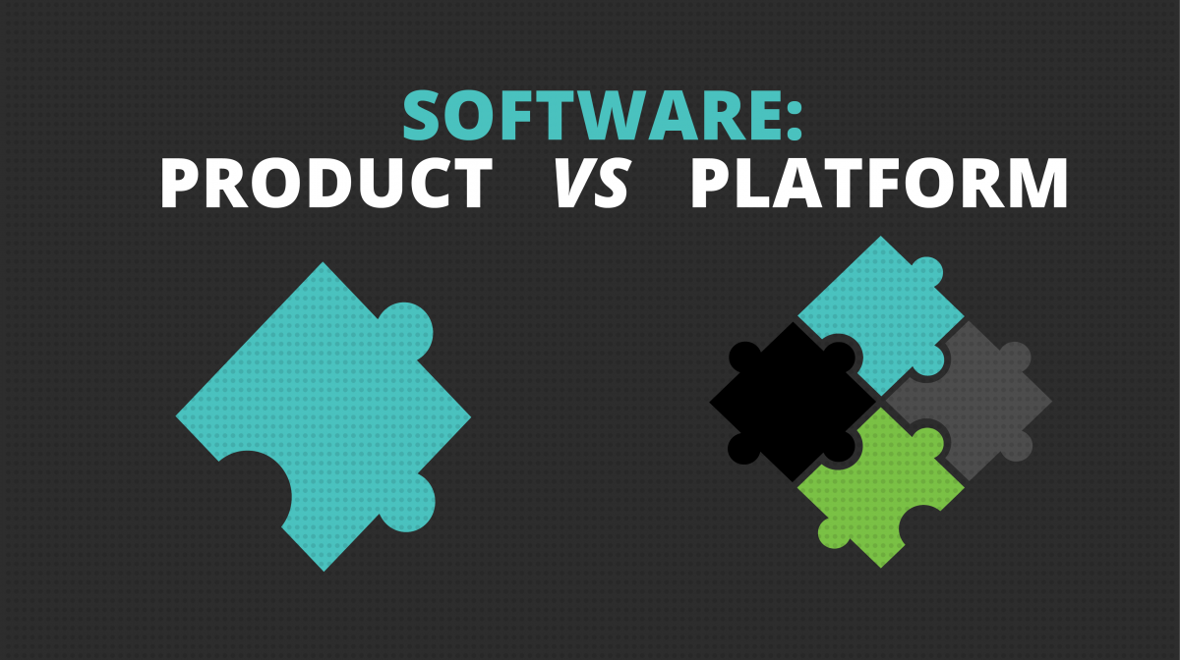
SOFTWARE PLATFORMS

Slide 19
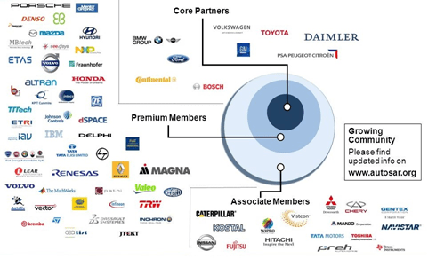
The AUTOSAR Consortium
AUTomotive Open System ARchitecture (AUTOSAR) is a global development partnership of automotive interested parties founded in 2003. It pursues the objective to create and establish an open and standardized software architecture for automotive Electronic Control Units (ECUs).
Notes:
https://medium.com/@autonom/autosar-fundamentals-what-is-autosar-part-1-ac6198c4b075

Slide 20
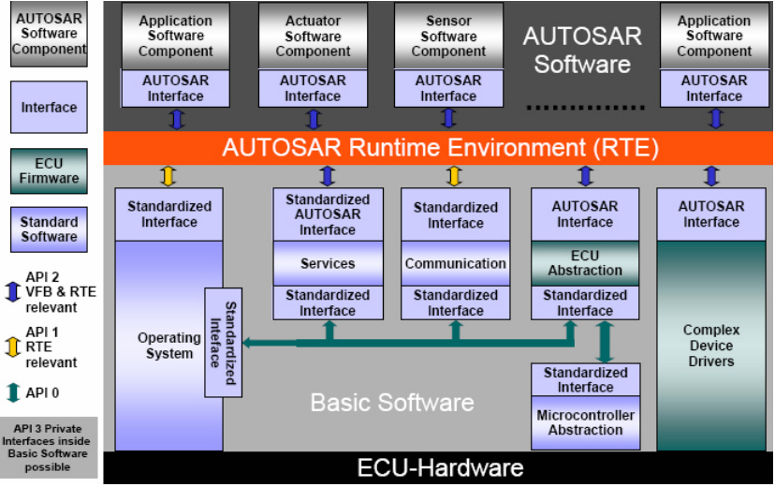
AUTOSAR Classic Platform
Notes:
https://www.nxp.com/design/automotive-software-and-tools/autosar-/autosar-4-3-x-classic-platform-software:AUTOSAR-4-3 https://www2.informatik.uni-erlangen.de/teaching/thesis/download/i2S00428.pdf

Slide 21
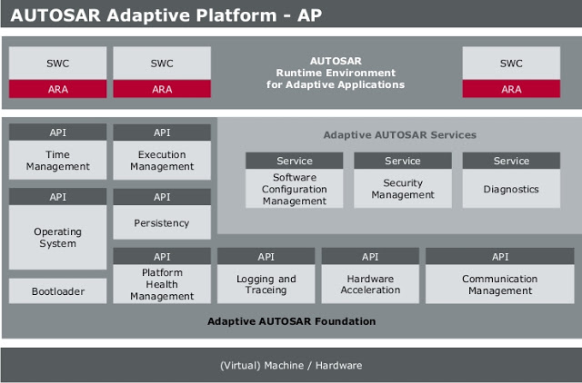
AUTOSAR Adaptive Platform
AUTOSAR-AP is an industry standard that specifies standard interfaces required for developing future high-performance multicore automotive ECUs.
Compared to Classic AUTOSAR for resource-constrained safety-critical ECUs, AUTOSAR-AP is designed for high-performance ECUs, and allows dynamic linking of services and clients during ECU runtime, which facilitates Over-the-Air (OTA) Update.
Notes:
These interfaces allow OEMs, as in the car manufacturers, to implement AD, over-the-air software updates, IoT (Internet of Things) features, media streaming and other services to their future cars.

Slide 22
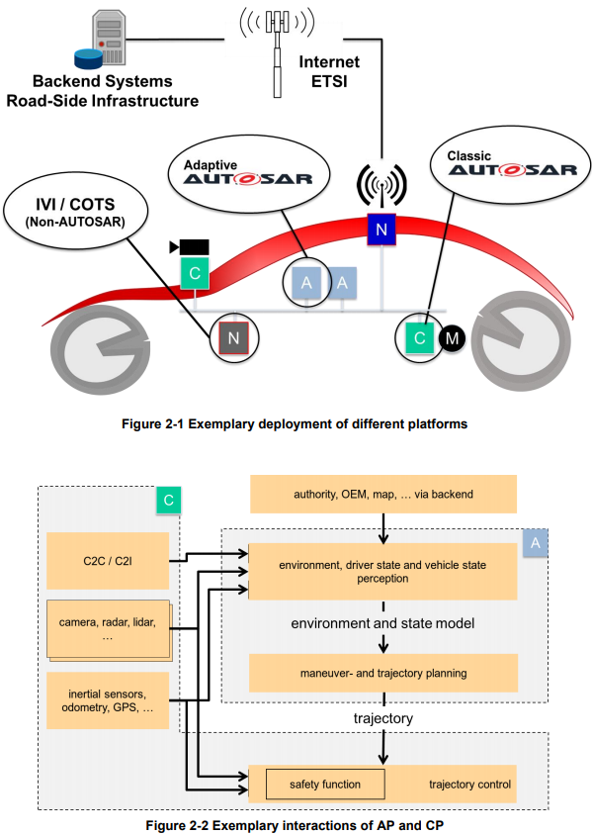
Integration of Multiple Software Platforms
AUTOSAR CP (labeled C) is used for safety-critical ECUs for low-level control and interfacing with actuators
AUTOSAR AP (labeled A) is used for high-performance AD computer.
Non-AUTOSAR (labeled N) may be Linux or Android, for non-safety-critical IVI (In-Vehicle Infotainment) and COTS (Commercial Off-the-Shelf) applications.
Notes:
https://www.autosar.org/fileadmin/user_upload/standards/adaptive/17-03/AUTOSAR_EXP_PlatformDesign.pdf

Slide 23
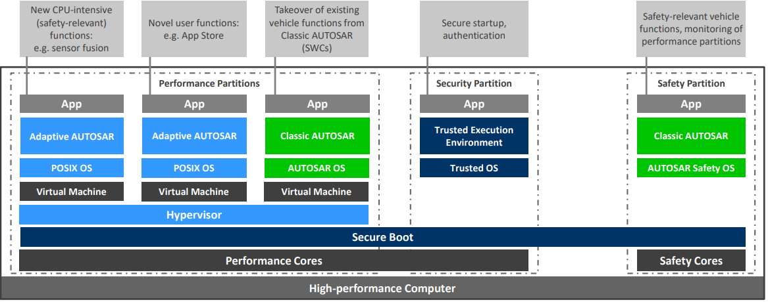
EB corbos
EB corbos is a software platform that uses virtualization technology (hypervisor) to integrate AUTOSAR AP, CP and non-AUTOSAR OS on a single multicore ECU, while achieving high degree of isolation between different Virtual Machine partitions, including:
Performance Partitions with complex Performance Cores for high-performance, subject to low-levels of safety certification
Safety Partition with simpler Safety Cores for safety-critical functions, subject to high-levels of safety certification
Security Partition with processor security extensions (e.g., ARM TrustZone, Intel Software Guard Extensions (SGX)) for secure boot, crypto operations, etc.
An example of a Mixed-Criticality System, where subsystems with different safety criticality levels are integrated on the same platform

Slide 24
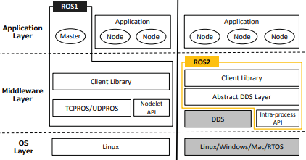
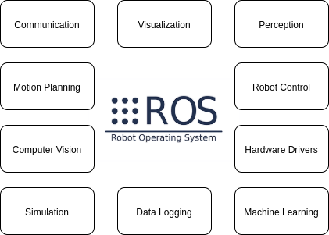
Robot Operating System (ROS)
ROS is a set of software libraries and tools for building robotic applications. Many companies use ROS to develop AVs. It uses the publish-subscribe paradigm for inter-node communication.
ROS has a Master node that provides naming and registration services to the rest of the nodes.
ROS 2 removed the Master node, and uses publish-subscribe middleware DDS (Data Distribution Service).
A drawback of ROS compared to AUTOSAR:
Since ROS uses Linux as the OS, it is not possible to pass high-level of safety certification (ASIL-D).
Maruyama Y, Kato S, Azumi T. Exploring the performance of ROS2[C]//Proceedings of the 13th International Conference on Embedded Software. 2016: 1-10.
Notes:
https://maker.pro/ros/tutorial/robot-operating-system-2-ros-2-introduction-and-getting-started https://www.esol.com/embedded/ros.html Right figure shows integration of ROS, ROS 2, AUTOSAR on top of a Real-Time Operating System eMCOS.

Slide 25
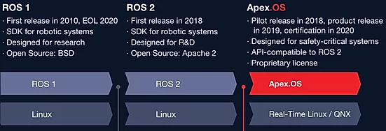
Apex.OS
“Safe and certified software framework for autonomous mobility systems.”
Aims to be certified as a Safety Element out of Context (SEooC) up to ASIL D.
Hard real-time, static memory allocation (no new() or malloc()), callbacks vs. waitset, security, testing, real-time I/O logging…
Real-Time Linux or QNX as the RTOS.

Slide 26
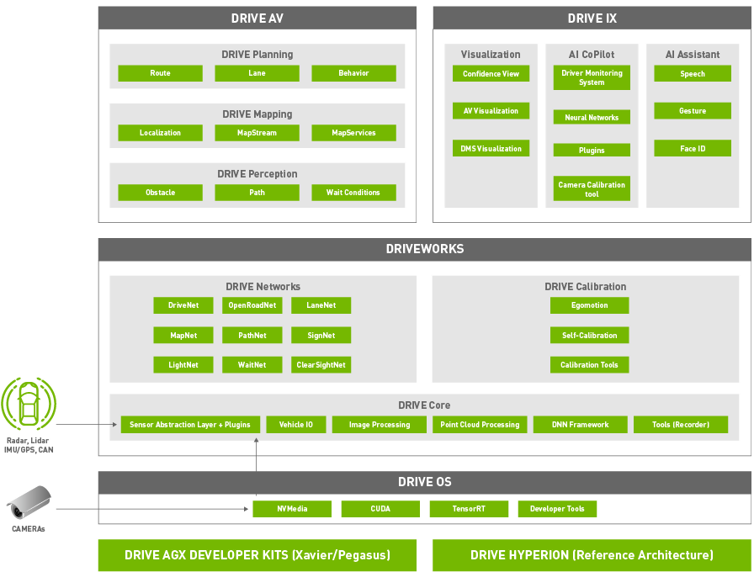
NVIDIA DRIVE Software Framework
Notes:
https://developer.nvidia.com/drive/drive-software https://gigazine.net/gsc_news/en/20190319-nvidia-self-driving-cars/

Slide 27
NVIDIA DRIVE Software Framework
An open-source framework for AD (only for NVIDIA hardware).
DRIVE OS is a foundational software stack consisting of an embedded Real Time OS (RTOS), hypervisor, CUDA libraries, Tensor RT, and other modules that give you access to the hardware engines.
DriveWorks SDK enables developers to implement AV solutions by providing a comprehensive library of modules, developer tools, and reference applications.
DRIVE AV provides perception, mapping, and planning modules that utilize the DriveWorks SDK.
DRIVE IX provides full cabin interior sensing capabilities needed to enable AI cockpit solution.

Slide 28
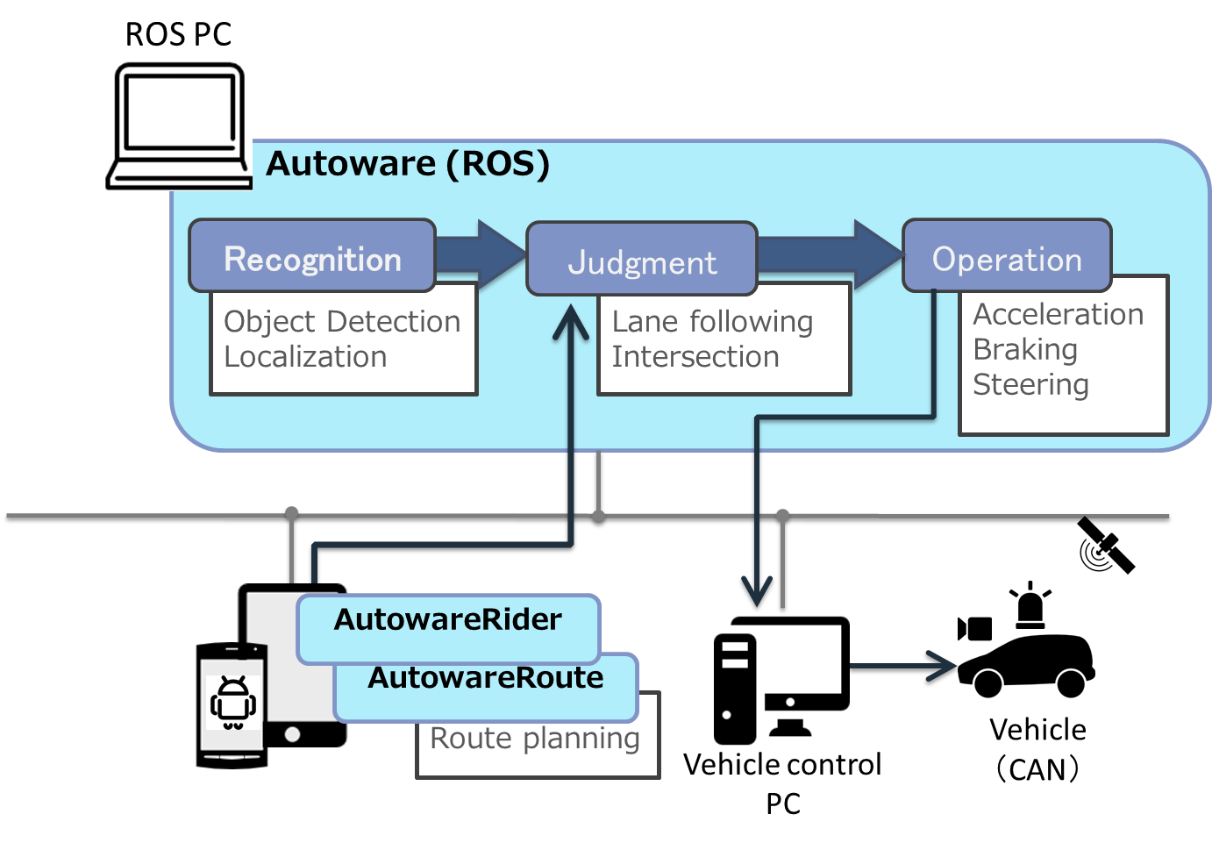
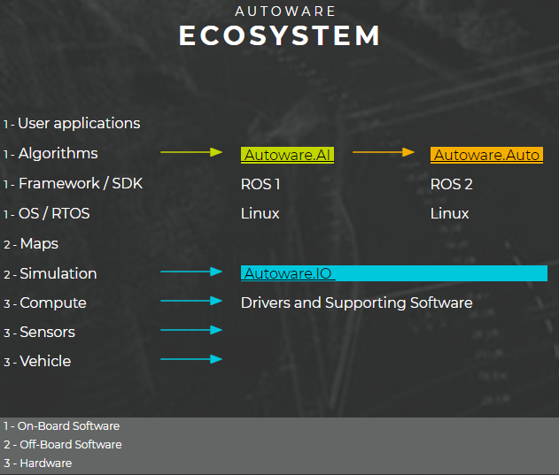
Autoware
Open-source AD platform from Japan.
Autoware.AI (https://www.autoware.ai) is based on ROS-1.
Autoware.auto (https://www.autoware.auto) is the new version based on ROS2.
Notes:
Nagoya University.
Today, Autoware.AI is supported by the largest autonomous driving open source community with 2300+ stars on GitHub and 500+ accounts on Slack (10/2018).
Autoware.AI has found widespread and international adoption as it is used by more than 100 companies and runs on more than 30 vehicles in more than 20 different countries.
Courses using Autoware are offered in 5 countries.
Automotive OEMs are using Autoware for Mobility as a Service (MaaS) development.
Autoware is qualified to run on

Slide 29
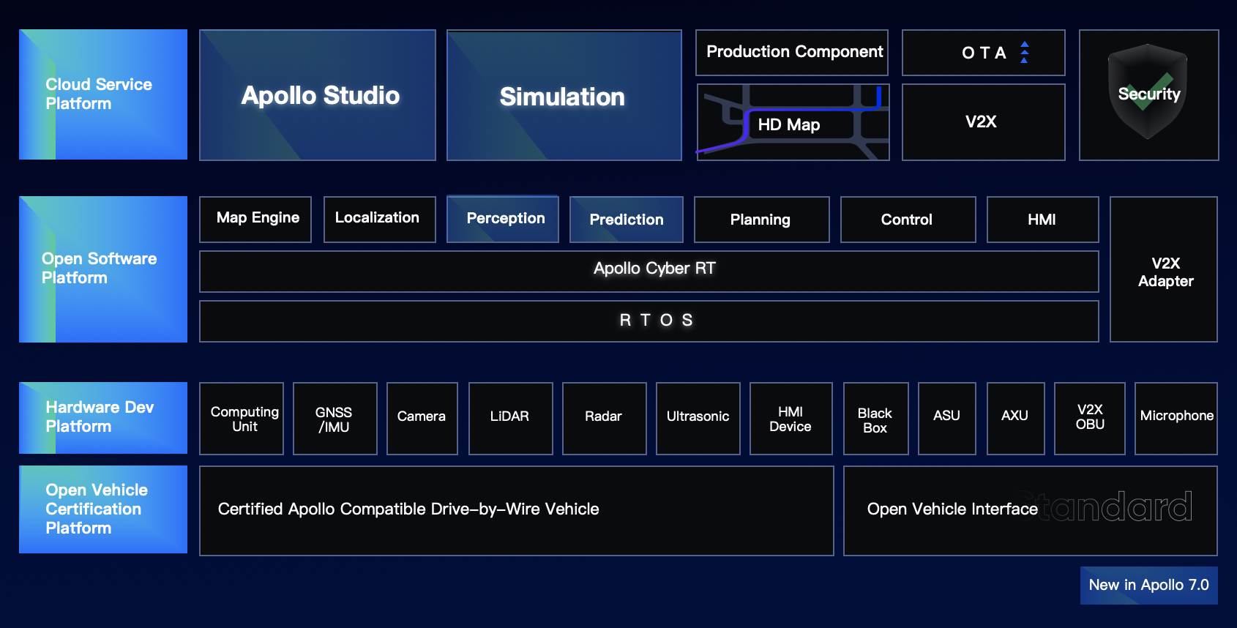
Baidu Apollo
An open-source, hardware-neutral AD platform from China.
Initially based on ROS, but later replaced ROS with their own components.
Real-Time Operating System (RTOS); Linux kernel with real-time patch
Cyber RT: lightweight, high-performance communication middleware

Slide 30
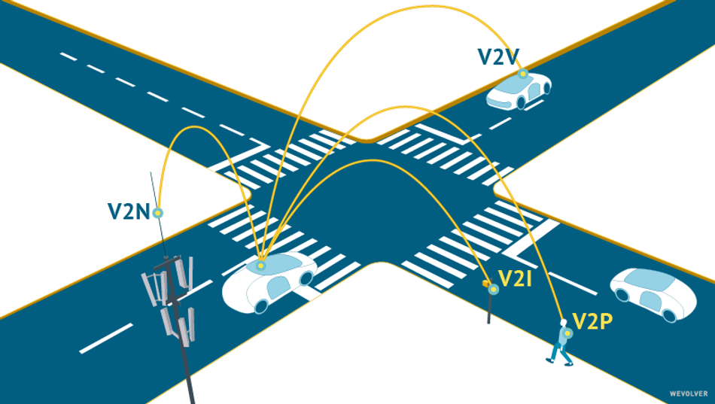
V2X

Slide 31
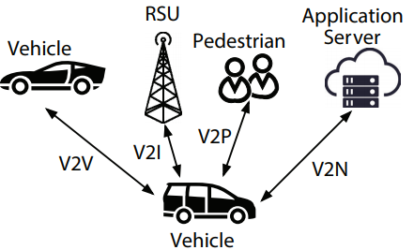
V2X Types
Four types of V2X applications in 3GPP Standard:
Vehicle-to-Vehicle (V2V)
e.g., collision avoidance system
Vehicle-to-Pedestrian (V2P)
e.g., safety alerts to pedestrians and bicyclists
Vehicle-to-Infrastructure (V2I)
e.g., adaptive traffic light control, traffic-light optimal speed advisory
Vehicle-to-Network (V2N)
e.g., real-time traffic routing, cloud services
Also called Vehicle-to-Cloud
Notes:
Diff from Wi-Fi: OCB (Outside the Context of a Basic Service Set), no authentication
10Hz, 300-500m range
The current way to safely operate automated vehicles is reliant on a lot of onboard sensors and cameras, but some situations are still hard to predict. V2X techniques could offer the possibilities of AVs to “literally see around corners” [1].
Ford, has together with many other OEMs, spent a lot of effort looking at dedicated short-range communications (DSRC) a vehicle-specific dialect of Wi-Fi for communications between vehicles as well as with infrastructure (V2X) during recent years. Now, Ford is changing direction to instead aim for a cellular-based vehicle-to-everything technology (C-V2X) which they consider a more promising technology for this purpose. “This is the right step to take” according to the executive director of Ford’s connected vehicle-platform, Don Butler. Leveraging 5G mobile communications technology, C-V2X could ride along with the upgrade of existing cell towers and road antennas to create an easy and elegant transition towards safer operation of automated vehicles. Butler argues that deployment of DSRC would instead require billions of dollars invested in building new infrastructure, rather than upgrading the existing one.
Automated vehicles are currently dependent on cameras, radar, lidar and such to drive safely in different environments, but less information is available regarding what these vehicles can’t see due to physical obstacles. For instance, a vehicle that has abruptly stopped behind a road turn could be invisible until an accident is too late to prevent. The deployment of C-V2X could on the other hand, offer a way for the trailing vehicle to predict its environment even before entering that same turn.
Ford has announced that it will be outfitting all of its new U.S. model with C-V2X technology starting 2022.
Personal comments
DSRC (or ITS-G5 as it’s called in Europe) works over a dedicated frequency band in the 5,9 GHz range that has been reserved for traffic safety purposes. Many, if not most, vehicle manufacturers have spent about 15 years on developing technology, protocols and services for this communications channel. However, an expected US regulatory framework that would make such a communication device mandatory on new vehicles, has not yet materialized. At the same time cellular technologies, particularly the 5th generation, has grown into a strong competitor to DSRC, and over the last few years there’s been a constant debate between these technologies, represented by manufacturers on each side and OEMs that have been struggling to decide in which direction to go.
During last year both VW and Toyota made somewhat surprising public statements about committing to DSRC, now to be followed by Ford going in the opposite direction. Most certainly this is only the beginning of a battle that will just continue. Possibly a hybrid solution, which is in the works, would be the best solution. Otherwise, given the recent announcement [2] about Ford and VW joining forces on certain technology development, the outcome of that process may indicate which technology will win.

Slide 32
Two Camps
DSRC (Distributed Short-Range Communication): Toyota, GM…
Based on WiFi, i.e., 802.11p at 5.9GHz
For latency-sensitive applications.
C-V2X (Cellular V2X): Qualcomm/Ford…
Traditionally for latency-tolerant applications e.g., Over-the-Air (OTA) updates.
With the advent of 5G, C-V2X will become more prevalent, used also for latency-sensitive applications.
C-V2X seems to be winning over DSRC in recent years. The following slides are based on Qualcomm’s C-V2X approach
https://www.qualcomm.com/media/documents/files/accelerating-c-v2x-commercialization.pdf
Notes:
WAVE (Wireless Access in the Vehicular Environment) or IPv6+TCP/UDP.

Slide 33
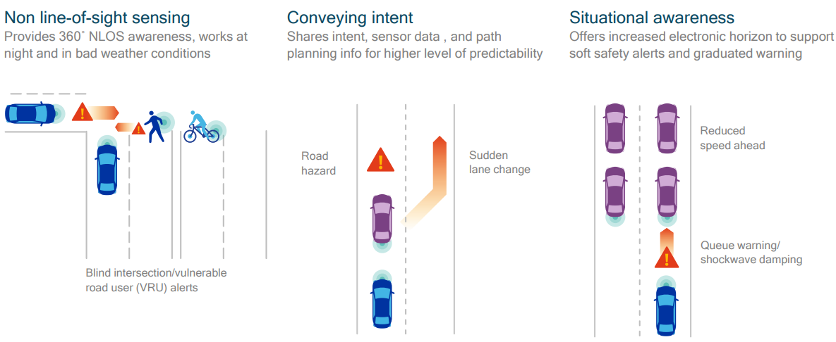
V2X Applications in AD
Notes:
(focused on LTE, but application scenarios are also applicable to 5G)

Slide 34
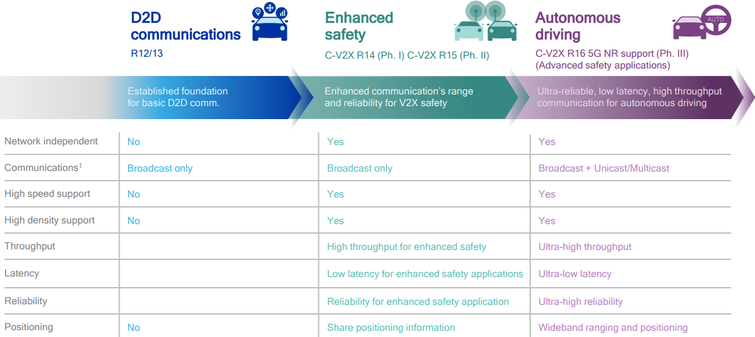
C-V2X Evolution towards 5G
In 2020/07, 3GPP (3rd Generation Partnership Project) declared R16 to be frozen

Slide 35
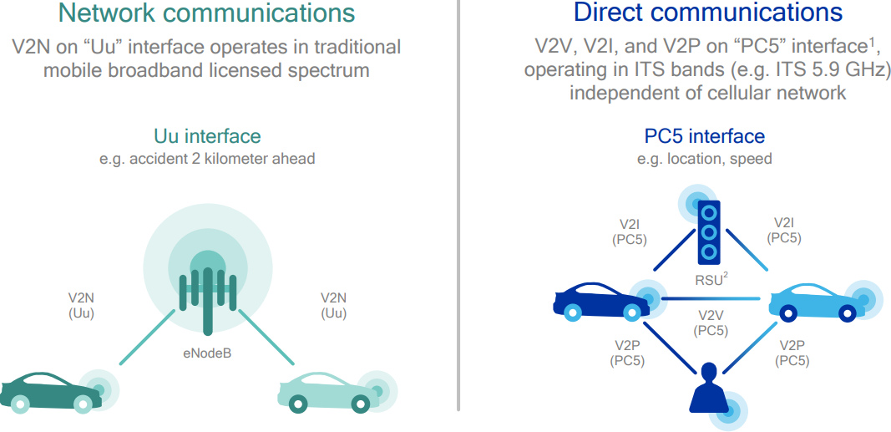
C-V2X Defines 2 Transmission Modes
V2X-Cellular: network communications going through base station (eNodeB)
V2X-Direct: Device-to-Device direct communications without going through base station

Slide 36
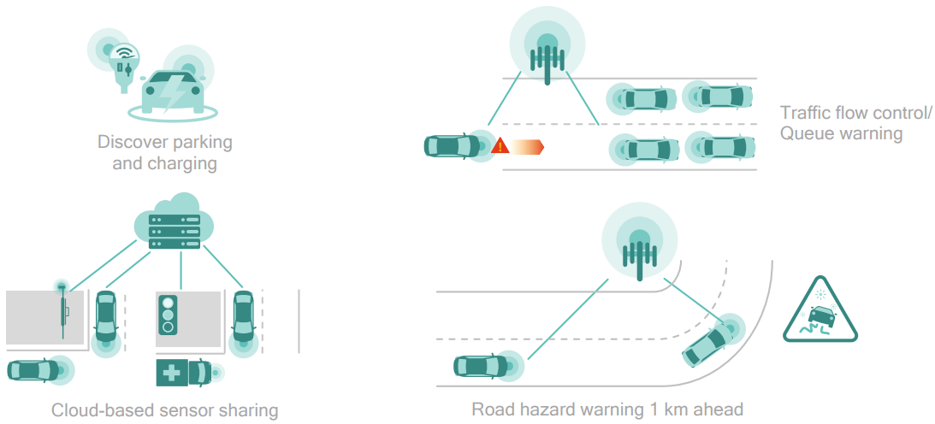
V2X-Cellular for Latency-Tolerant Use Cases

Slide 37
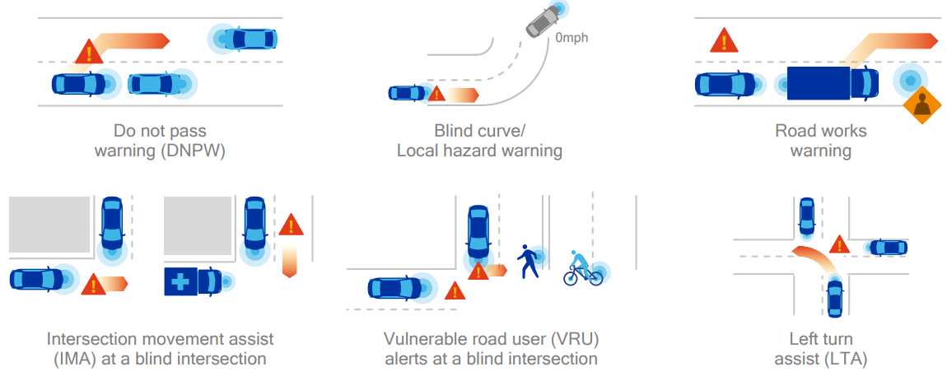
V2X-Direct for Latency-Sensitive Active Safety Use Cases
Useful for NLOS (Non-Line-of-Sight) scenarios.

Slide 38
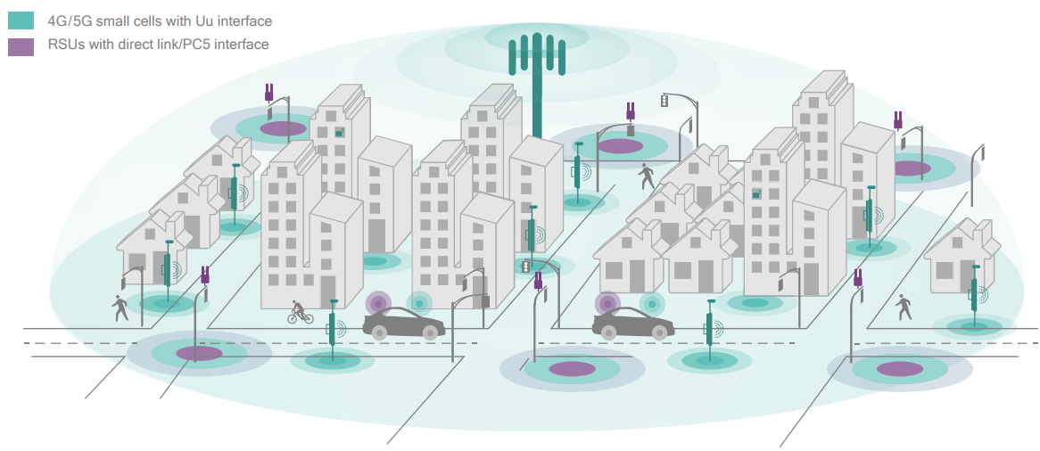
C-V2X Deployment
Combined RSUs (Road-Side Units) with direct link (PC5) interface for V2X-Direct, and 4G/5G base stations for V2X-Cellular, benefiting from cellular network densification in 5G (smaller and denser cells)

Slide 39
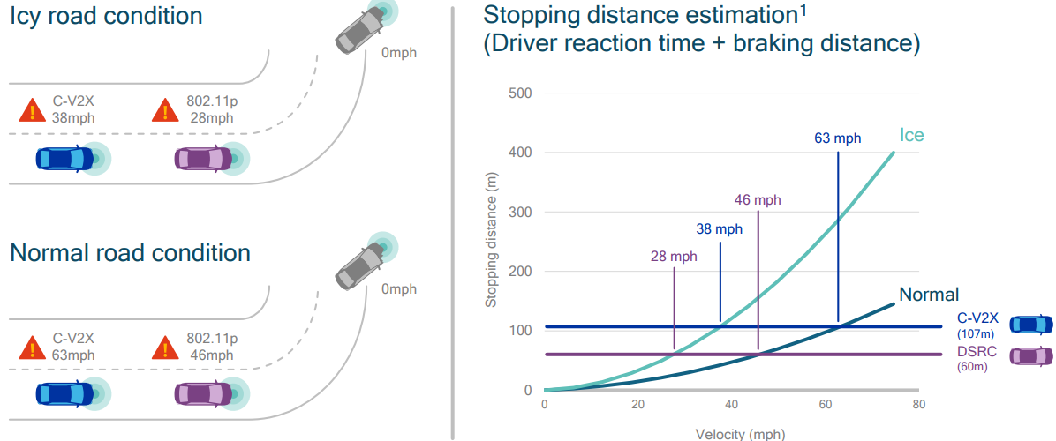
Use Case: Disabled Vehicle after Blind Curve
C-V2X has (at least 2x) longer range than DSRC/802.11p, which enables the ego-vehicle to get warning message earlier, hence travel at higher speed while avoiding collision with the disabled vehicle

Slide 40
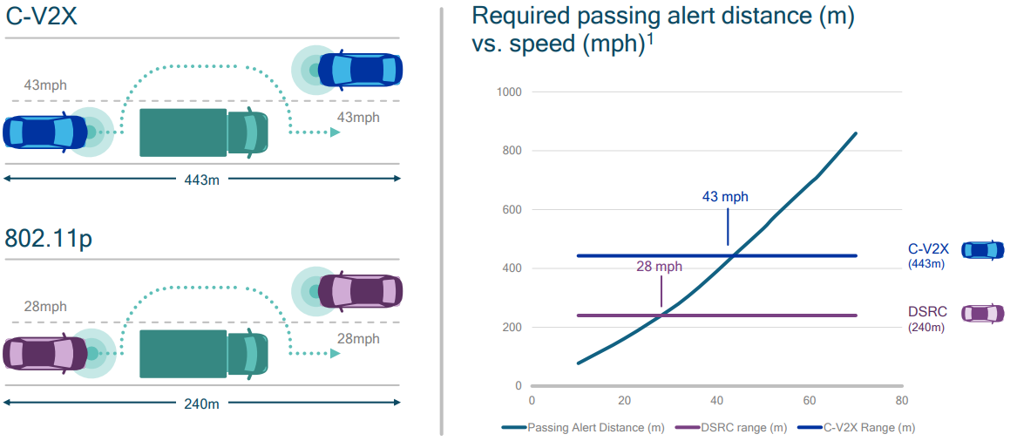
Use Case: Do Not Pass Warning
C-V2X’s longer range enables the ego-vehicle to get warning message earlier, hence travel at higher speed while avoiding collision with the disabled vehicle

Slide 41
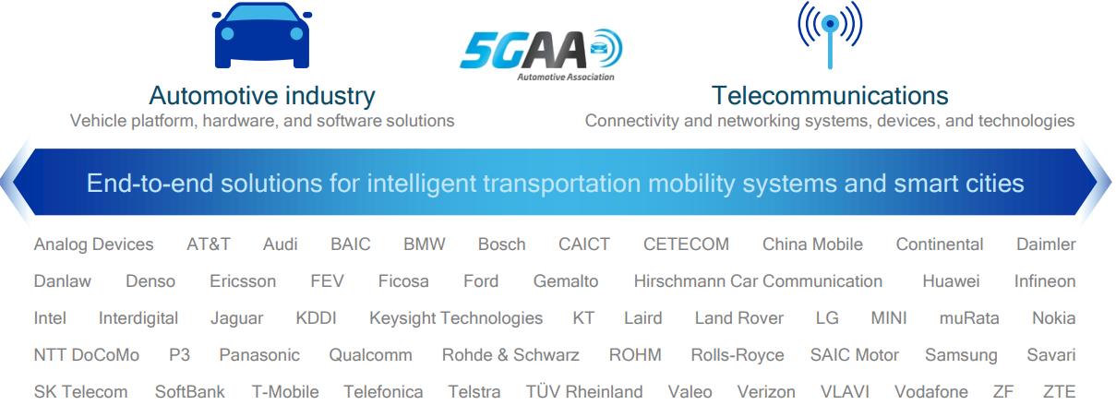
Industry Consortium
5GAA is a cross-industry consortium that defines 5G V2X communications

Slide 42
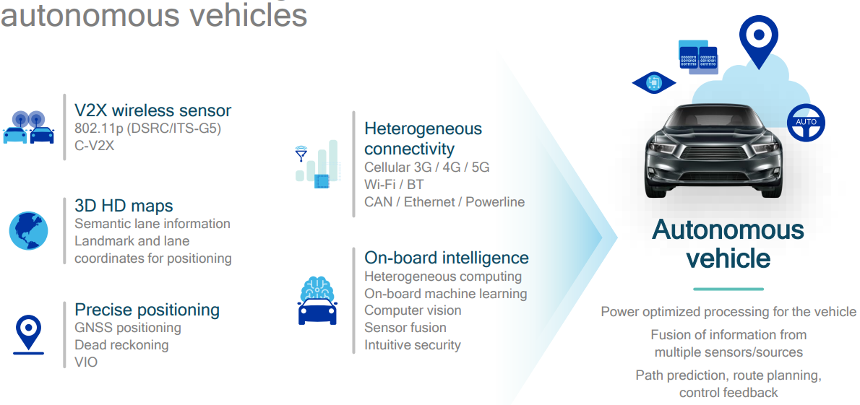
5G Accelerates AVs
My thoughts: Massive deployment of V2X is necessary for AVs to benefit from V2X; It is a promising technology, but current AV players are not counting on V2X.

